Slide 1
Recent Trends in ICT Developments

Slide 2
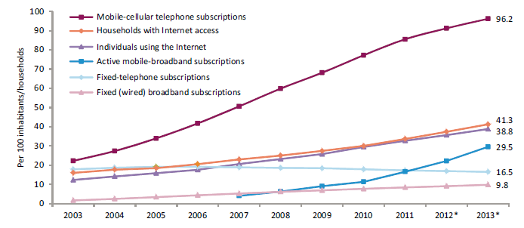
Global ICT developments, 2003-2013
There are about 6.8 billion mobile-cellular subscriptions
The challenge is to identify those who are still left without access to ICTs
Notes:
2.7 billion people using the Internet worldwide vs. 4.4 billion people who are not yet online

Slide 3
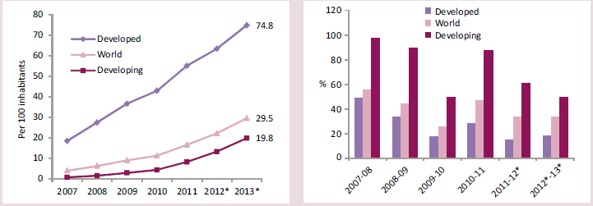
Active mobile-broadband subscriptions, world and by level of development, 2007-2013, penetration (left) and annual growth (right)
2 billion mobile-broadband subscriptions
Mobile broadband has been the fastest growing market
Notes:
corresponding to a global penetration rate of 30%.
a 40% average annual growth since 2007.
Growth rate is more in developing countries

Slide 4
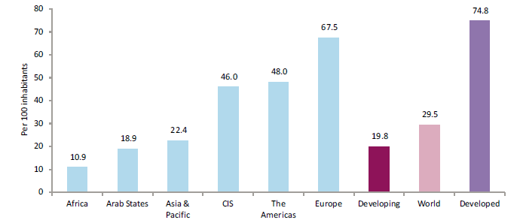
Active mobile-broadband subscriptions, by region and level of development, 2013
75% penetration in developed countries
20% penetration in developing countries
Notes:
Average for Arab states is below the world average, with only Africa below Arab States

Slide 5
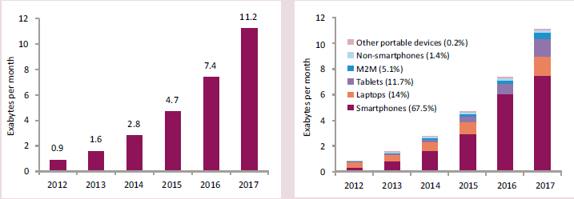
Mobile data traffic, 2012-2017 (forecasts), total (left) and by end-user device (right)
Cisco forecasts that global mobile data traffic will increase 13-fold between 2012 & 2017.
Two-thirds of this data traffic will be exchanged through smart phones.
Notes:
The use of Internet via wireless networks and devices will continue to grow rapidly.
Exa indicates the sixth power of 1,000 (10¹⁸ in the International System of Units (SI)).

Slide 6
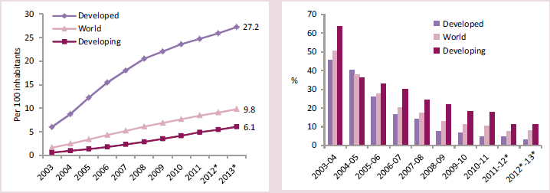
Fixed (wired)-broadband subscriptions, world and by level of development, 2003-2013, penetration (left) and annual growth (right)
Fixed broadband subscriptions are growing at a 10% annual average
Worldwide-growth is reducing due to slower growth in developed countries
Growth in developing countries continues at double-digit rates.
Notes:
Albeit more slowly than mobile broadband

Slide 7
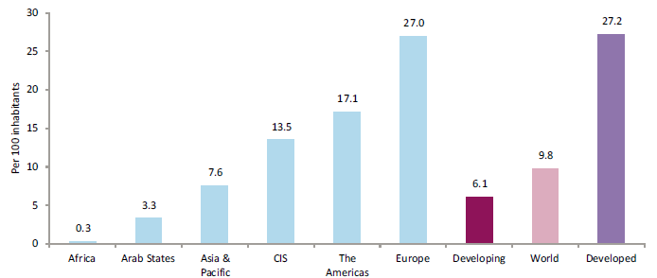
Fixed (wired)-broadband subscriptions, by region and level of development, 2013
Fixed-network infrastructure is less deployed in developing countries.
In Arab States, number of subscriptions is one-third the world average.
The fixed-broadband divide between developed and developing regions remains substantial.

Slide 8
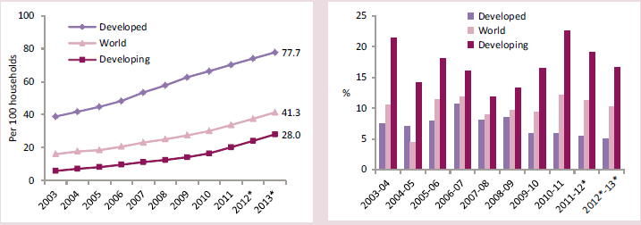
Households with Internet access, world and by level of development, 2003-2013, penetration (left) and annual growth (right)
The number of households with Internet access is increasing in all regions, but large differences persist between developed and developing countries
Penetration rates set to reach almost 80 percent in the former compared to 28 percent in the latter
Notes:
A key basic indicator to monitor consumer uptake is the number of households with access to the Internet.

Slide 9
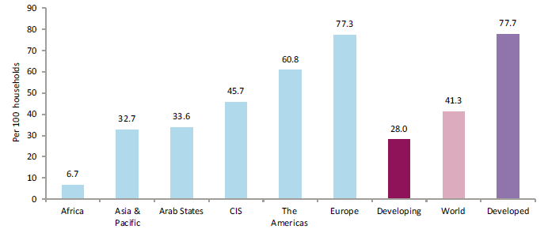
Households with Internet access, by region and level of development, 2013
The gap between Africa and Asia is substantial
There are 1.1 billion households worldwide that are not yet connected to the Internet, 90 percent of which are in the developing world.
Notes:
The lowest household Internet penetration is found in Africa.

Slide 10
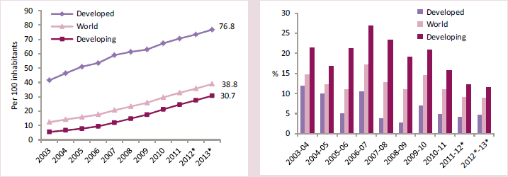
Individuals using the Internet, world and by level of development, 2003-2013, penetration (left) and annual growth (right)
Household connections are key for ensuring more inclusive and frequent Internet availability.
People can also access the Internet in other locations when household access is not available. This is particularly the case in rural areas of developing countries.
Notes:
???

Slide 11
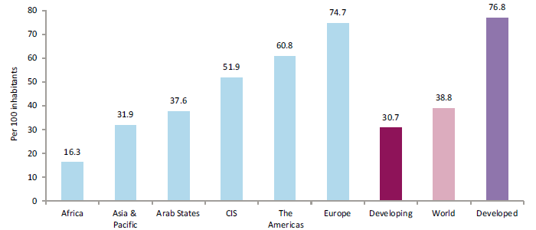
Individuals using the Internet, world and by level of development, 2003-2013
In Africa, the internet-user penetration has doubled in the last 4 years
This trend is largely driven by the emergence of mobile-broadband services
Arab States penetration rate is slightly below world average
Notes:
In Africa, internet-user penetration has doubled over the past four years, and is now about 16%.
This trend is largely driven by the emergence of mobile-broadband services in many countries, bringing Internet at lower prices to customers already using handsets.

Slide 12
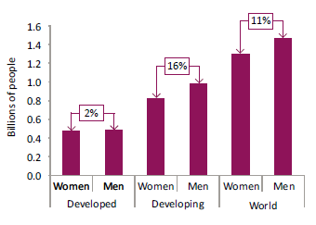
The ICT gender gap – Men and Women Online
There is a gender gap in the use of computers, mobile phones and the Internet.
This gender gap is more prevalent in developing than developed countries.

Slide 13
The ICT Development Index (IDI)

Slide 14
Definition and Background
The ICT Development Index (IDI) is a composite index combining 11 indicators into one benchmark measure that serves to monitor and compare developments in information and communication technology (ICT) across countries.
The IDI was developed by ITU in 2008 and first presented in the 2009 edition of “Measuring the Information Society”.
It was established in response to ITU Member States’ request to develop an ICT index and publish it regularly.

Slide 15
Objectives
Main objectives of the IDI are to measure:
The level and evolution over time of ICT developments in countries and relative to other countries;
Progress in ICT development in both developed and developing countries: the index should be global and reflect changes taking place in countries at different levels of ICT development;
The digital divide, i.e. differences between countries with different levels of ICT development;
The development potential of ICTs or the extent to which countries can make use of ICTs to enhance growth and development, based on available capabilities and skills.

Slide 16
Conceptual Framework
The ICT development process, and a country’s transformation to becoming an information society, can be depicted using the following three-stage model:
Stage 1: ICT readiness (reflecting the level of networked infrastructure and access to ICTs)
Stage 2: ICT intensity (reflecting the level of use of ICTs in the society)
Stage 3: ICT impact (reflecting the result/outcome of efficient and effective ICT use).

Slide 17
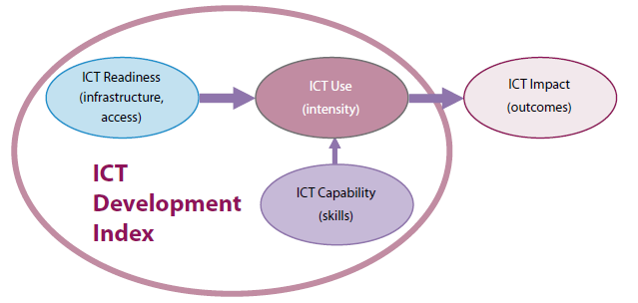
Conceptual Framework Three stages in the evolution towards an information society
Advancing through these stages depends on a combination of three factors:-
The availability of ICT infrastructure,
Access a high level of ICT usage,
The capability to use ICTs effectively.
Notes:
Accordingly, the first two stages listed above correspond to two major components of the IDI: ICT access and ICT use.

Slide 18
IDI Sub-Indices
Based on this conceptual framework, the IDI is divided into the following three sub-indices:
Access sub-index: Captures ICT readiness, and includes five infrastructure and access indicators.
Use sub-index: Captures ICT intensity, and includes three ICT intensity and usage indicators.
Skills sub-index: Captures ICT capability or skills as indispensable input indicators.

Slide 19
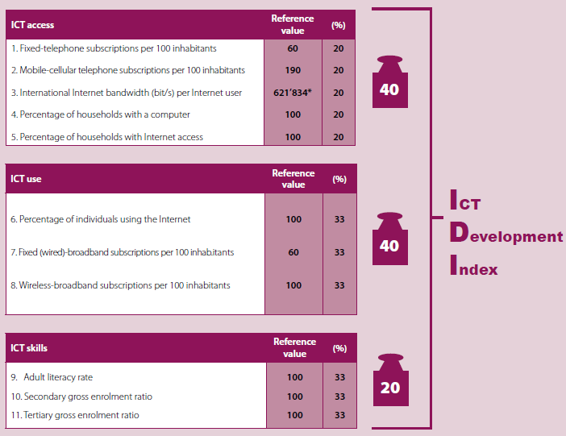
IDI Indicators, Reference Values and Weights

Slide 20
ICT Development Index (IDI), 2011 and 2012 in Some Selected Countries
Country | 2012 |  | 2011
 | Rank | IDI | Rank | IDI
Korea (Rep.) | 1 | 8.57 | 1 | 8.51
Singapore | 15 | 7.65 | 14 | 7.55
United Arab Emirates | 33 | 6.41 | 45 | 5.68
Lebanon | 52 | 5.37 | 61 | 4.62
Jordan | 76 | 4.22 | 77 | 3.90
Morocco | 89 | 3.79 | 89 | 3.59
Tunisia | 91 | 3.7 | 92 | 3.58
Syria | 102 | 3.22 | 99 | 3.13
Sudan | 119 | 2.33 | 118 | 2.19
Yemen | 127 | 1.89 | 129 | 1.76
Niger | 157 | 0.99 | 157 | 0.93

Slide 21
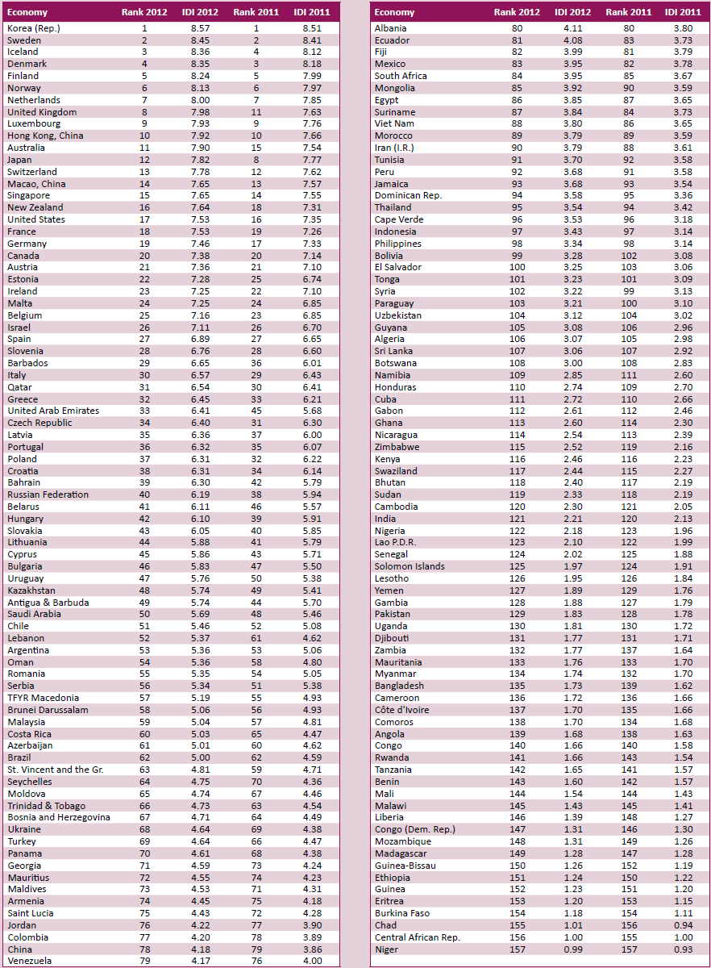

Slide 22
Thank you for your attention.

Slide 23
Reference
Measuring Information Society, 2013, International Communication Union, Geneva (http://www.itu.int/en/ITU-D/Statistics/Documents/publications/mis2013/MIS2013_withoutAnnex_4.pdf).

